Slide 1
Computation and Analysis on Reinhardt Polygons with Multiple Prime Divisors
Molly Feldman, Robert Kenyon, Jiahui Liu
Summer@ICERM

Slide 2
Reinhardt Polygons
is a convex polygon in the plane with sides
has four relevant properties
Area
Perimeter
Diameter
Width
There are 3 extremal problems
Reinhardt polygons are optimal in all three problems

Slide 3
Reinhardt Polygons (cont.)
Polynomial:
Coefficient array:
Polygon
Composition:

Slide 4
Representations
Polygons
Must have a “star” cycle in it’s center (shown in blue)
Each angle in the star can be represented as a multiple of the angle
All diameters cross one another
Notes:
Helpful uses: concrete and aesthetically pleasing

Slide 5
Representations (cont.)
Polynomials
is divisible by
has alternating sign and all coefficients are elements of
has an odd number of nonzero coefficient
In most cases, we restrict
Notes:
Helpful uses: mathematically and computationally easiest to work with, in polynomial form for theory and in coefficient array form for computation

Slide 6
Representations (cont.)
Compositions
Composition of is a sequence of positive integers whose sum is
We represent a Reinhardt polynomial as a composition of the number of “gaps” between nonzero terms
Must always have an odd number of terms
For n = 30,
Notes:
Benefits: space efficiency and storage

Slide 7
Dihedral Equivalence
All representations of Reinhardt polygons are unique up to action by the dihedral group
Polygons: rotating and/or mirroring
Polynomials: multiplying by a power of ,
Compositions: rotating and/or mirroring

Slide 8
Dihedral Equivalence
b
a
a
c
c
b

Slide 9
Representations (cont.)
Compositions (cont.)
Not all compositions are unique
If m is the length of the composition, there are 2m equivalent dihedral compositions

Slide 10
Normalization
Method to create one unique representation of a polygon
Start: [ 3 4 1 1 2 1 4 5 2 1 1 1 2 1 1 ]
[ 3 4 1 1 2 1 4 5 2 1 1 1 2 1 1 ]
End: [ 5 4 1 2 1 1 4 3 1 1 2 1 1 1 2 ]

Slide 11
Sporadic vs. Periodic
Periodic Reinhardt polygons are those where the composition repeats periodically
Sporadic polygons are Reinhardt polygons which are not periodic
e.g. [15 15 15] = [ ]
e.g. [7 4 1 1 2 3 1 2 5 5 2 1 3 2 1 1 4]

Slide 12
Previous Results
The number of periodics is known for all
For almost all , the number of sporadic polygons exceeds the number of periodic ones
Let be the number of sporadic Reinhardt polygons for a given

Slide 13
Alternate Representation
From previous work, we can define
This representation restricts the problem of finding valid Reinhardt polynomials (i.e. ) to finding valid and
+ 0 0 − + 0
+ 0 0 − + 0 − 0 0 + − 0 + 0 0 − + 0 …

Slide 14
Previous Results (cont.)
In the two prime case,
where we construct nontrivial and
In the three prime case,

Slide 15
Second Construction
Goal: find valid and such that they satisfy the alternate representation,
and the other necessary properties
Notes:
Note that degree(f1) < pr and degree(f2) < qr

Slide 16
Second Construction
We know
Goal: find specific and such that this equation holds
To do so, we utilize the following algorithm, also known as “the second construction”
Remember:
Notes:
Note that degree(f1) < pr and degree(f2) < qr

Slide 17
+ 0 0 − + 0 − 0 0 + − 0 + 0 0 − + 0 − 0 0 + − 0 + 0 0 − + 0
0 0 0 + − 0 0 + − 0 0 0 0 − + 0 0 − + 0 0 0 0 + − 0 0 + − 0
+ 0 0 0 0 0 − + − + − 0 + − + − + − 0 0 0 + − + 0 0 0 0 0 0

Slide 18
Second Construction (cont.)
Let be a composition of into an even number of parts:
We decompose and into blocks of terms, i.e.

Slide 19
Second Construction (cont.)
+ … +
0
− … +
0
− … +
……
0
− … +
0
− … +
0
……
- following this formula: Ai,j belongs to {…}, Bi,j belongs to {…}, j going from 1 to 2m, i from 1 to p for A (or 1 to q for B)
- Example: n=30=2*3*5, r=2, p=3, q=5, c=(1,1)
- …
- can see that it’s always alternating

Slide 20
Second Construction (cont.)
+ … +
0
− … +
0
− … +
……
0
− … +
0
− … +
0
……
- following this formula: Ai,j belongs to {…}, Bi,j belongs to {…}, j going from 1 to 2m, i from 1 to p for A (or 1 to q for B)
- Example: n=30=2*3*5, r=2, p=3, q=5, c=(1,1)
- …
- can see that it’s always alternating

Slide 21
+ − 0 0 0 0 − + 0 0 0 0 + − 0 0 0 0 − + 0 0 0 0 + − 0 0 0 0
0 0 + 0 − + 0 0 − + 0 0 − 0 + − 0 0 + − 0 0 + 0 − + 0 0 − +
+ − + 0 − + − + − + 0 0 0 − + − 0 0 0 0 0 0 + 0 0 0 0 0 − +

Slide 22
Analysis of Second Construction
It has been proven that this algorithm only gives us Reinhardt polygons (although many dihedrals)
Counting the number of periodics and sporadics we obtain a lower bound on by dividing by the total number of possible dihedrals
Notes:
Computationally efficient, and seems to find all RP’s for 2 primes (not proved though)

Slide 23
Goals
Find sporadics for a given n
Determine the total number of unique polygons for a given n
Computationally
and
Theoretically

Slide 24
EXTENSIONS TO 3 DISTINCT PRIME DIVISORS

Slide 25
Third Construction
We generalized the second construction to include a third distinct prime factor, , so now we have with
Goal is to determine nontrivial and such that
is a valid Reinhardt polynomial
What we did was we generalized this algorithm to include a third prime factor, ie n=pqLr, with r composed into a number of parts divisible by 3: (r1,r2,…,r3m)
-We add a third row: C1 to CqL, and modify the other 2 rows:
- modified formulas: Ai,j belongs to {…}, Bi,j …, Ci,j …
- still always alternating => only gives RP’s
- modified combinatorics, new lower bound:

Slide 26
Third Construction (cont.)
Let be a composition of into parts such that :
We decompose , , and into blocks of terms, i.e.
r composed into a number of parts divisible by 3: (r1,r2,…,r3m)
-We add a third row: C1 to CqL, and modify the other 2 rows:
- modified formulas: Ai,j belongs to {…}, Bi,j …, Ci,j …

Slide 27
Third Construction (cont.)
+ … +
0
0
− … +
0
……
0
− … +
0
0
− … +
……
0
0
− … +
0
0
……

Slide 28
Teddy’s Slides

Slide 29
Third Construction (cont.)

Slide 30
Analysis of the Third Construction
The total number of Reinhardt polygons produced by the third construction is
If , i.e. , then the number of periodics produced is

Slide 31
Analysis (cont.)

Slide 32
Analysis (cont.)
If we let , i.e. in the previous equation, and , we obtain

Slide 33
FINDING SPORADIC 105-GONS

Slide 34
Previously Known Results
There are ~ 245 million periodic Reinhardt 105-gons
We think there are over 350 million sporadic 105-gons
We can only determine around 60% of all sporadic Reinhardt 105-gons using the second construction

Slide 35
Relevant Challenges
Computational Limits
Current solution: restricting search space
Determining Uniqueness
Current solution: normalization

Slide 36
New Generation Methods
Enumerating all possible , , and is computationally impossible
This is on order of
Requires a new approach: if we can restrict one of , , and , then we can obtain a more attainable runtime

Slide 37
First Program
For , has degree 35, has degree 21, and has degree 15
We can cycle through all possibilities for and and then restrict the possible ’s
Example: if the coefficients of and sum to 2, then the coefficient of must be -1 to maintain the coefficient restrictions for

Slide 38
Not Enough Restrictions
The previous technique is still on order
But we can specify unique base cases and obtain some results
How else can we generate more sporadic 105-gons?
Enter: Addition of Sporadic Polynomials

Slide 39
Adding Polynomials
Maintains divisibility by implicitly
Check for alternating, an odd number of nonzero terms, and

Slide 40
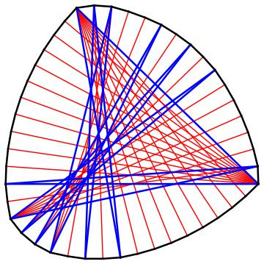
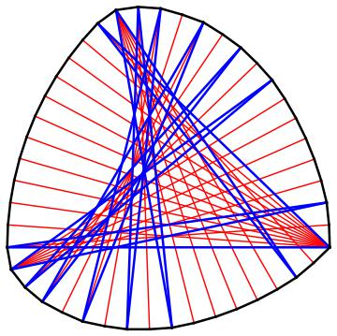
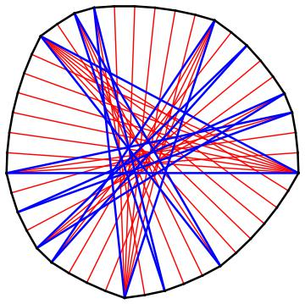
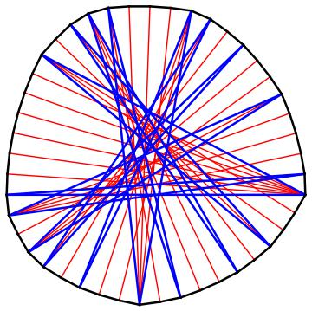
F1: [11, 9 , 1 , 2 , 1 , 2 , 3 , 1 , 2 , 1 , 2 , 1 , 6 , 2 , 1]
F2: [11, 2 , 1 , 6 , 1 , 2 , 1 , 2 , 2 , 2 , 2 , 1 , 2 , 1 , 6 , 1 , 2]
F3: [7, 6, 2, 3, 1, 2, 6, 4, 2, 1, 3, 2, 1, 2, 3]
F1 - F2 +F3: [7, 3 , 2 , 2 , 1 , 3 , 1 , 2 , 4 , 3 , 1 , 2 , 2 , 1 , 3 , 2 , 4 , 1 , 1]
-
+
=

Slide 41
Applications
We applied addition to two problems:
Determining a generating set for n = 45
Helps test the validity of the method
All n = 45 sporadic polygons are known
Finding previously unknown 105-gons

Slide 42
Generating Sets for n = 45
We found multiple generating sets
Example: 20 sporadic polygons, the which generate the entire sporadic set,
144 sporadics
20

Slide 43
Adding to Obtain More 105-gons
Start by using the first program to generate a small set of 105-gons
Add the 105-gons together, combine the results and then iterate
Note: adding polynomials is on order of

Slide 44
New Results for n = 105
We’ve been able to generate over 135,823 sporadic Reinhardt polygons
87,773 had not been previously determined by the second construction
35.4%
64.6%

Slide 45
What’s Next?
Given enough computational power and space management, we can find all sporadic Reinhardt 105-gons

